Slide 1
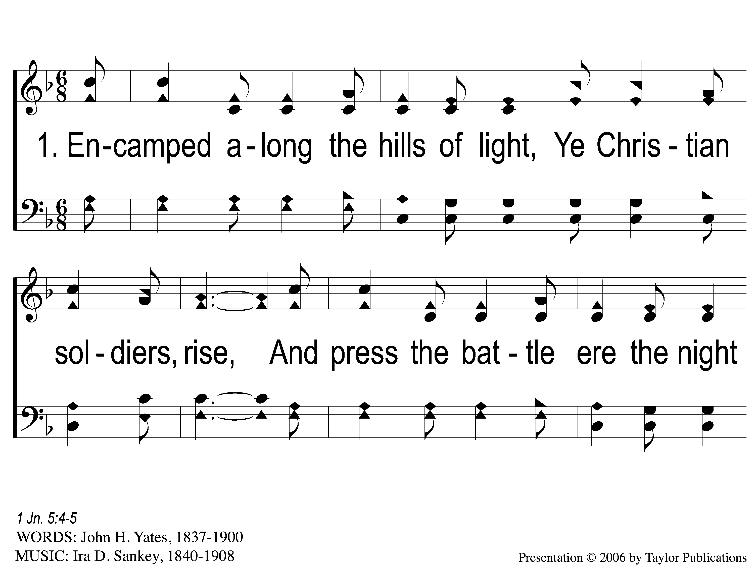
1-1 Faith is the Victory
Encamped along the Hills of Light
97

Slide 2
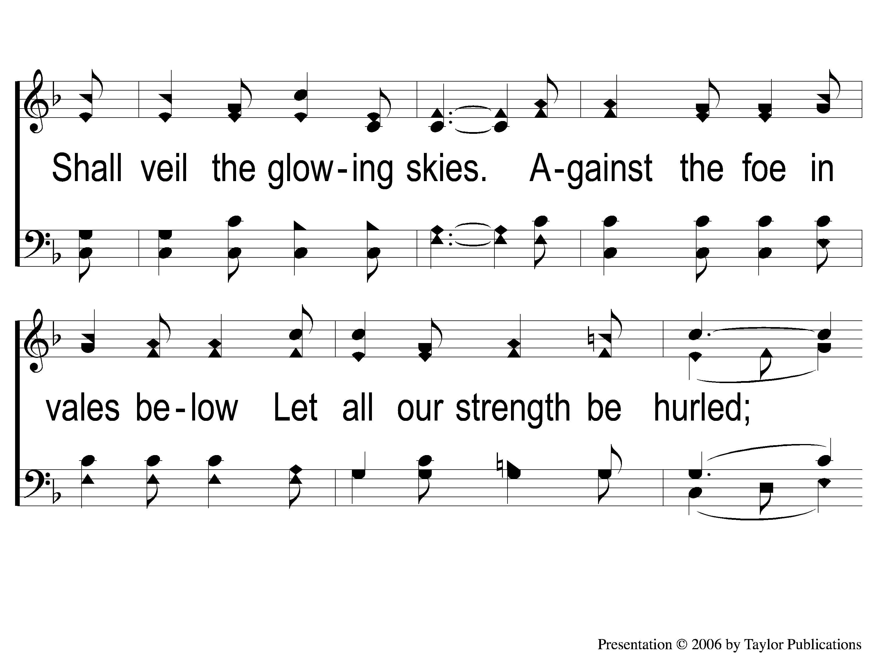
1-2 Faith is the Victory
Faith Is The Victory
97

Slide 3
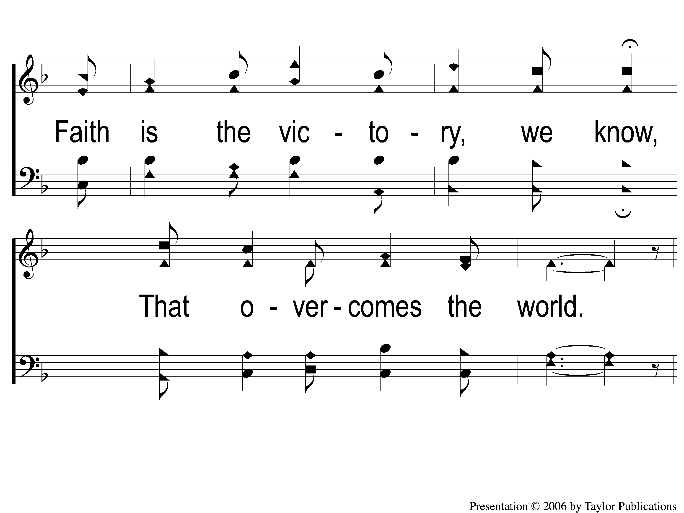
1-3 Faith is the Victory
Faith Is The Victory
97

Slide 4
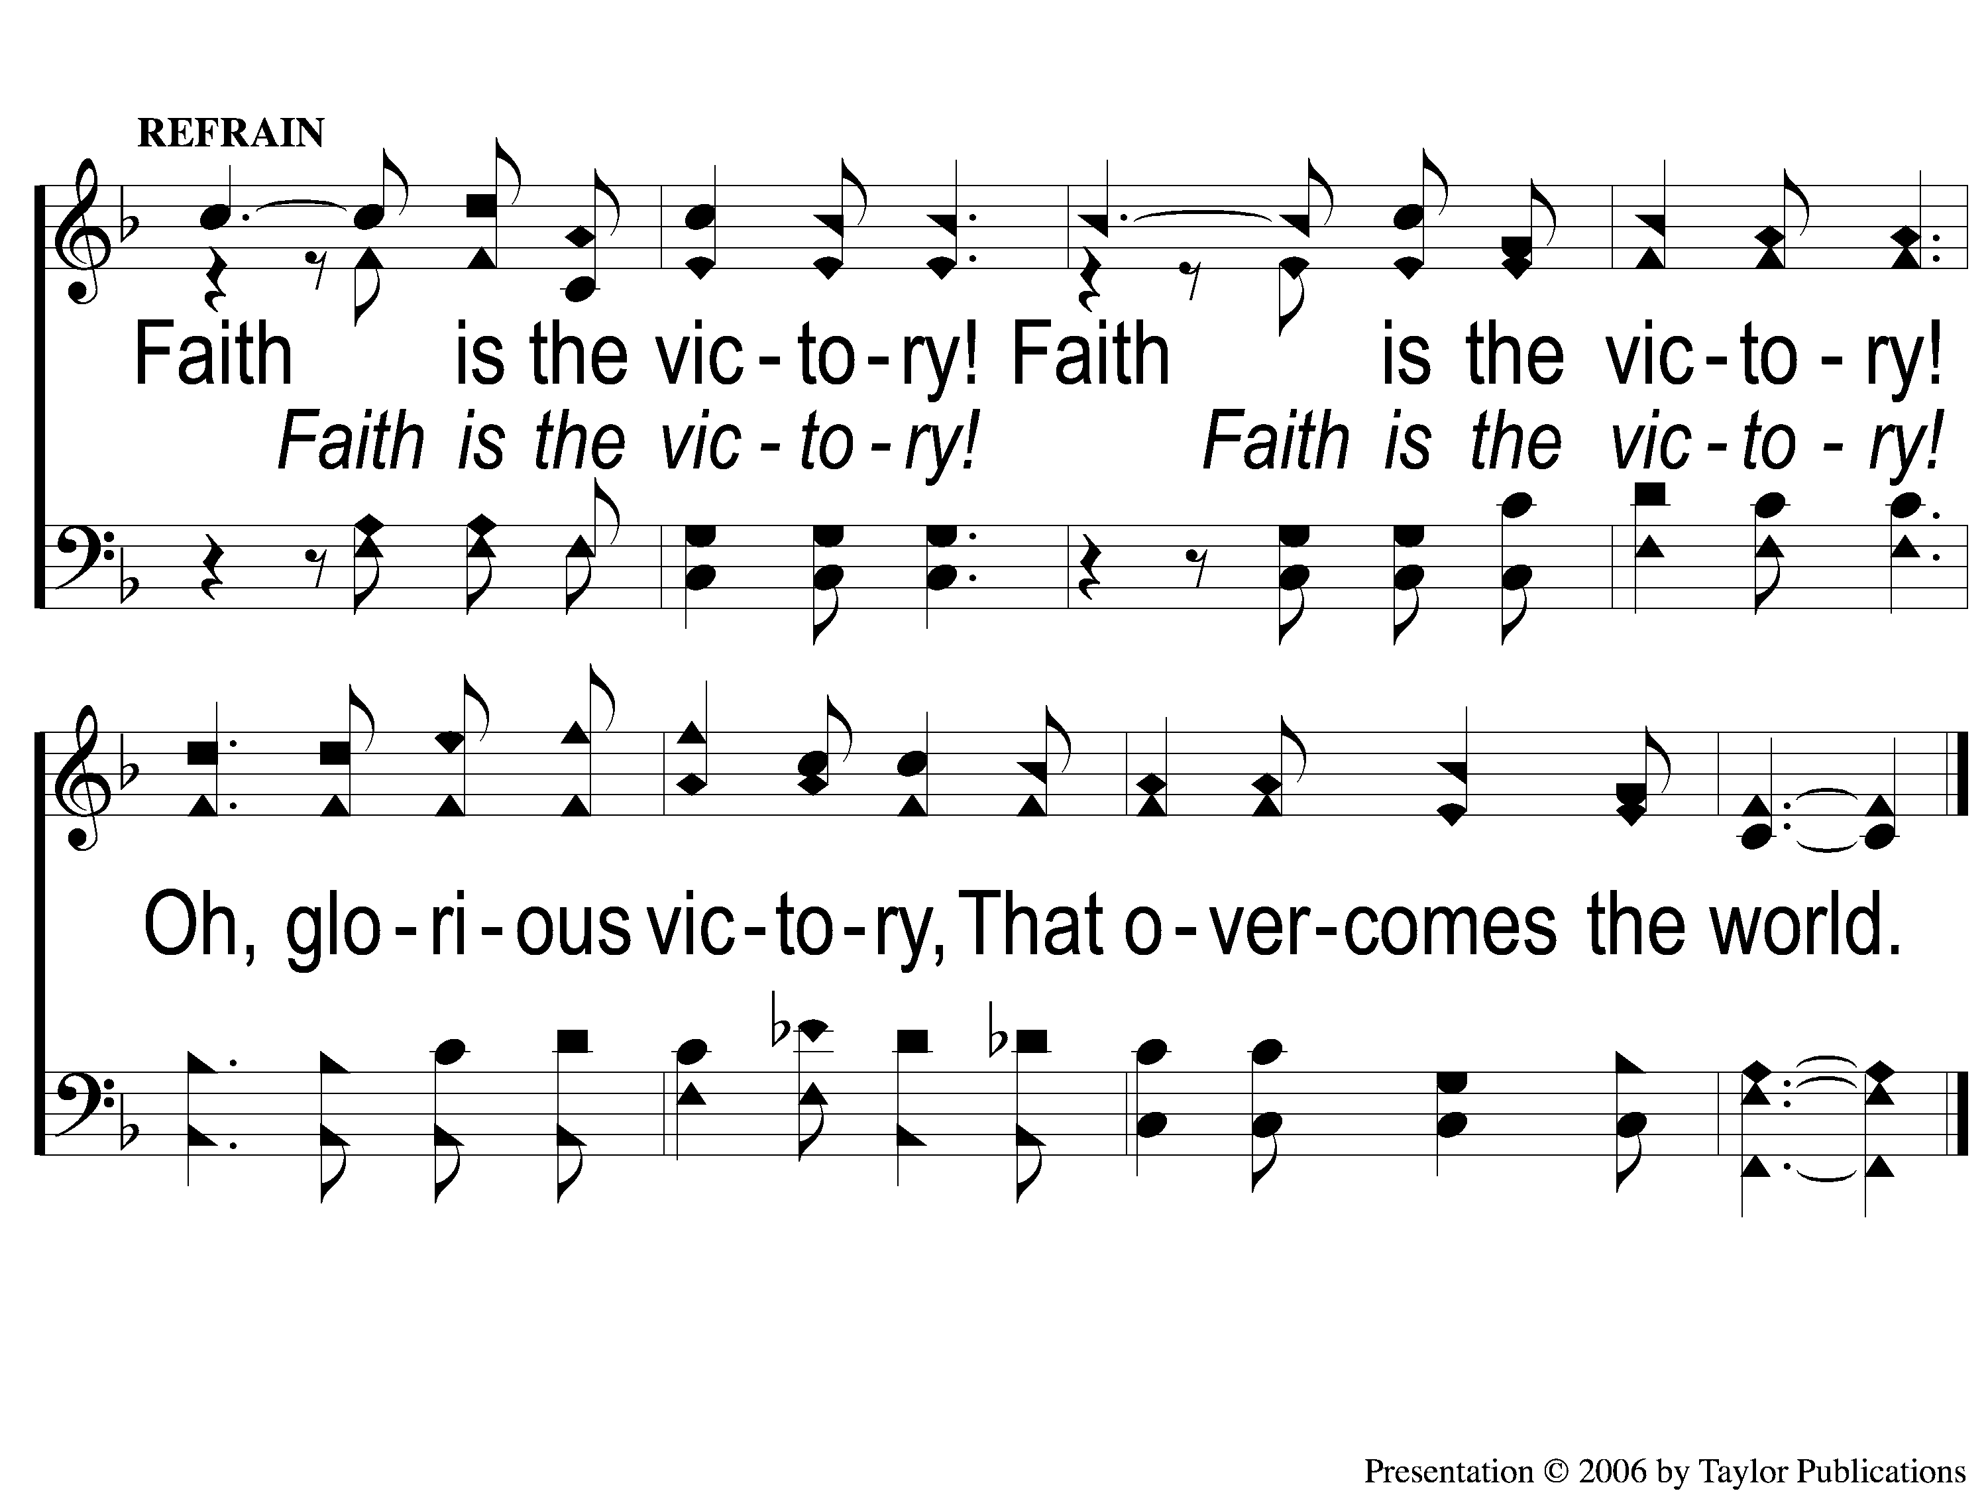
C-1 Faith is the Victory
Faith Is The Victory
97

Slide 5
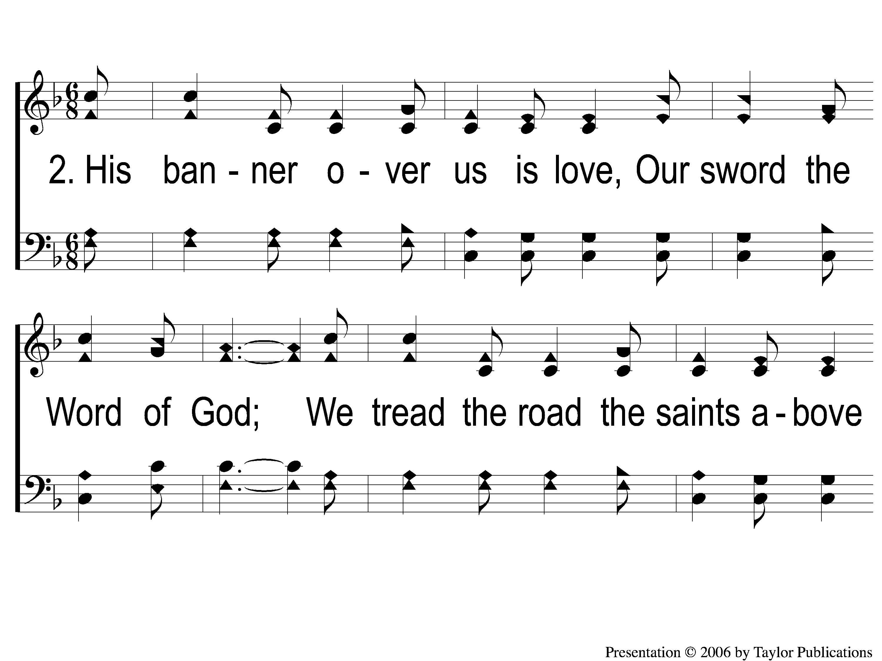
2-1 Faith is the Victory
Faith Is The Victory
97

Slide 6
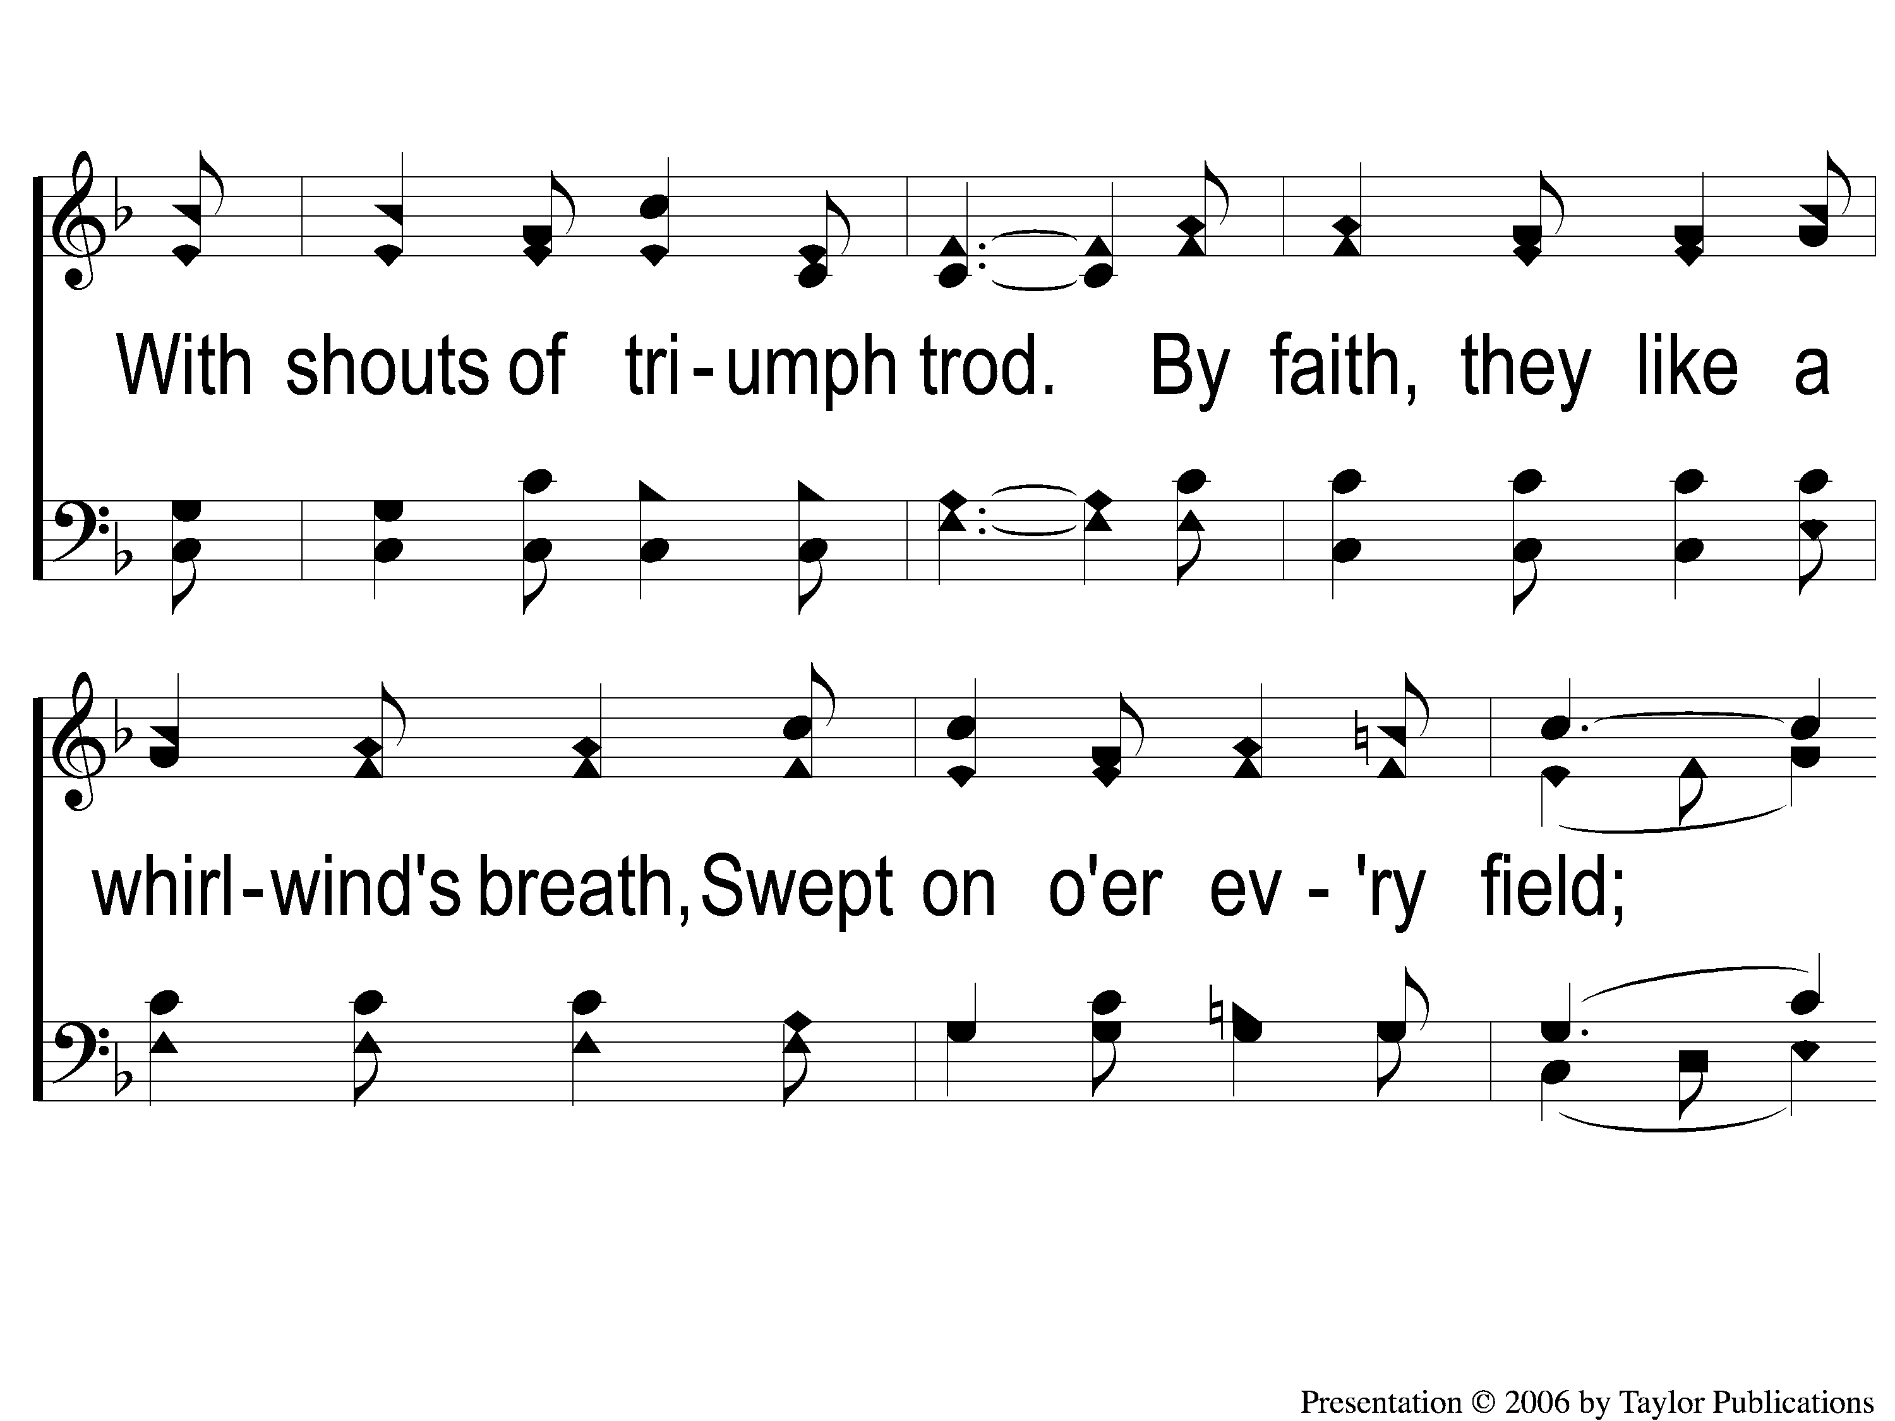
2-2 Faith is the Victory
Faith Is The Victory
97

Slide 7
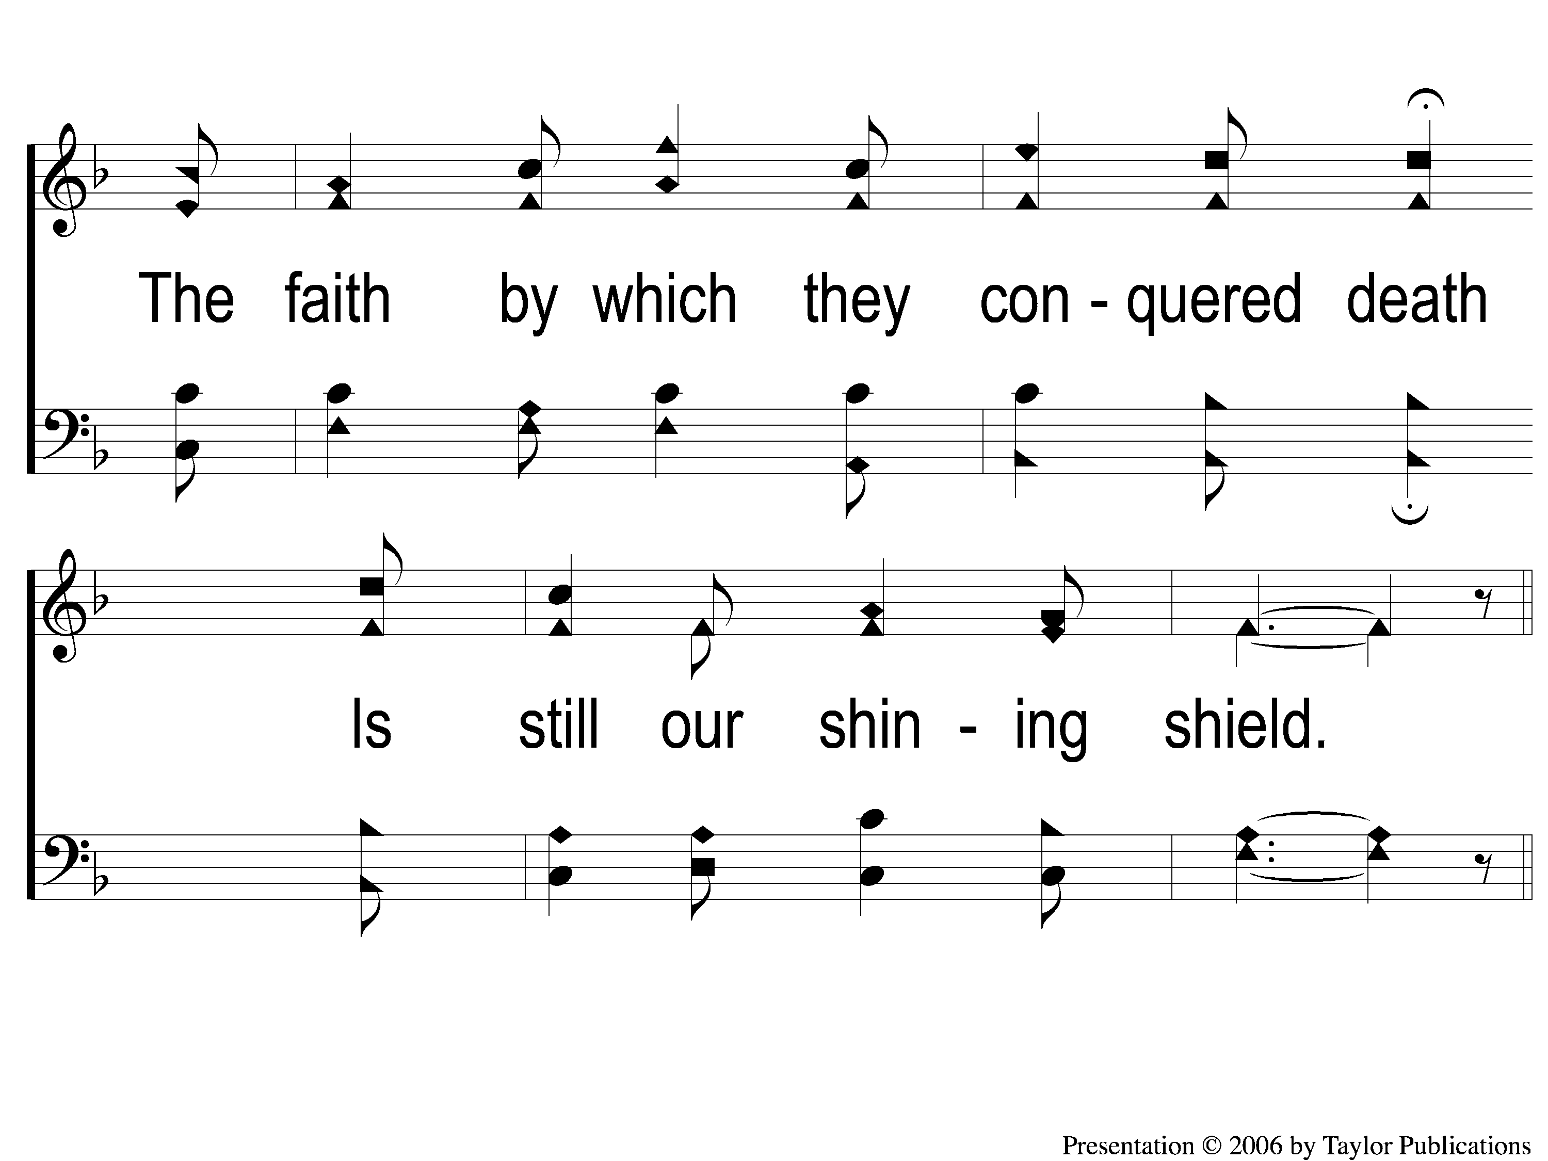
2-3 Faith is the Victory
Faith Is The Victory
97

Slide 8
C-1 Faith is the Victory
Faith Is The Victory
97

Slide 9
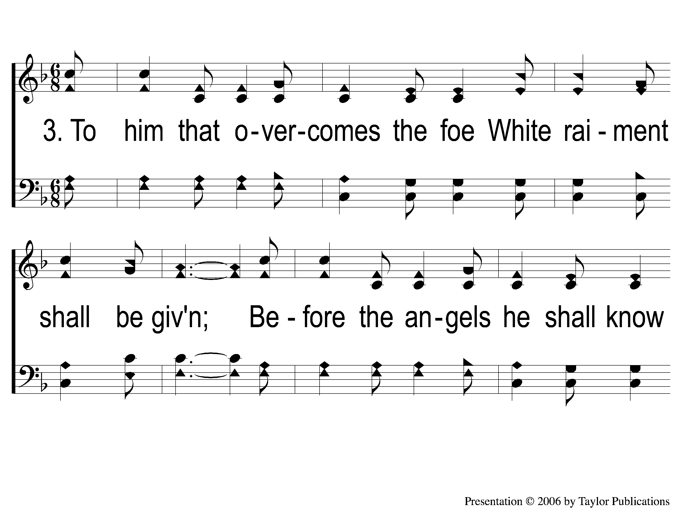
3-1 Faith is the Victory
Faith Is The Victory
97

Slide 10
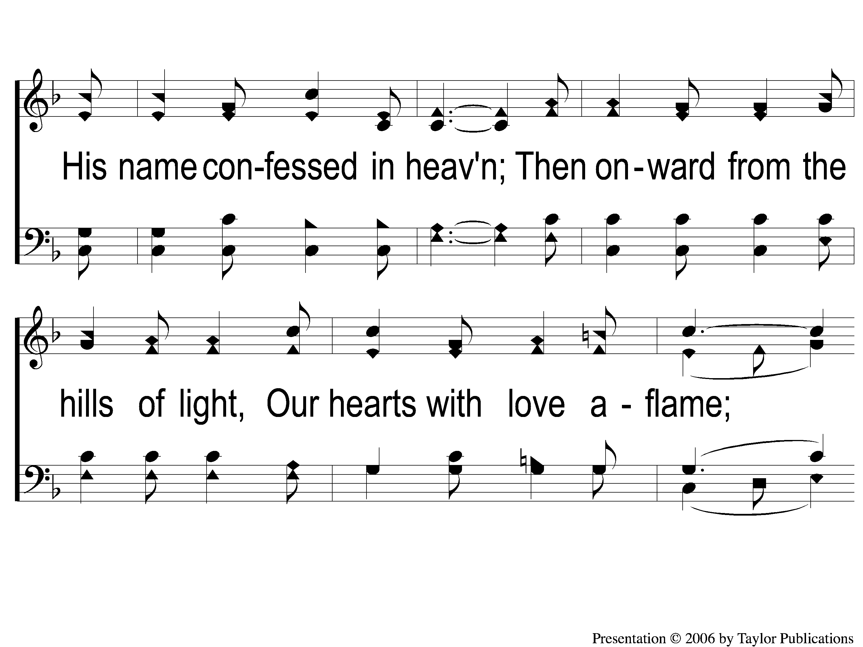
3-2 Faith is the Victory
Faith Is The Victory
97

Slide 11
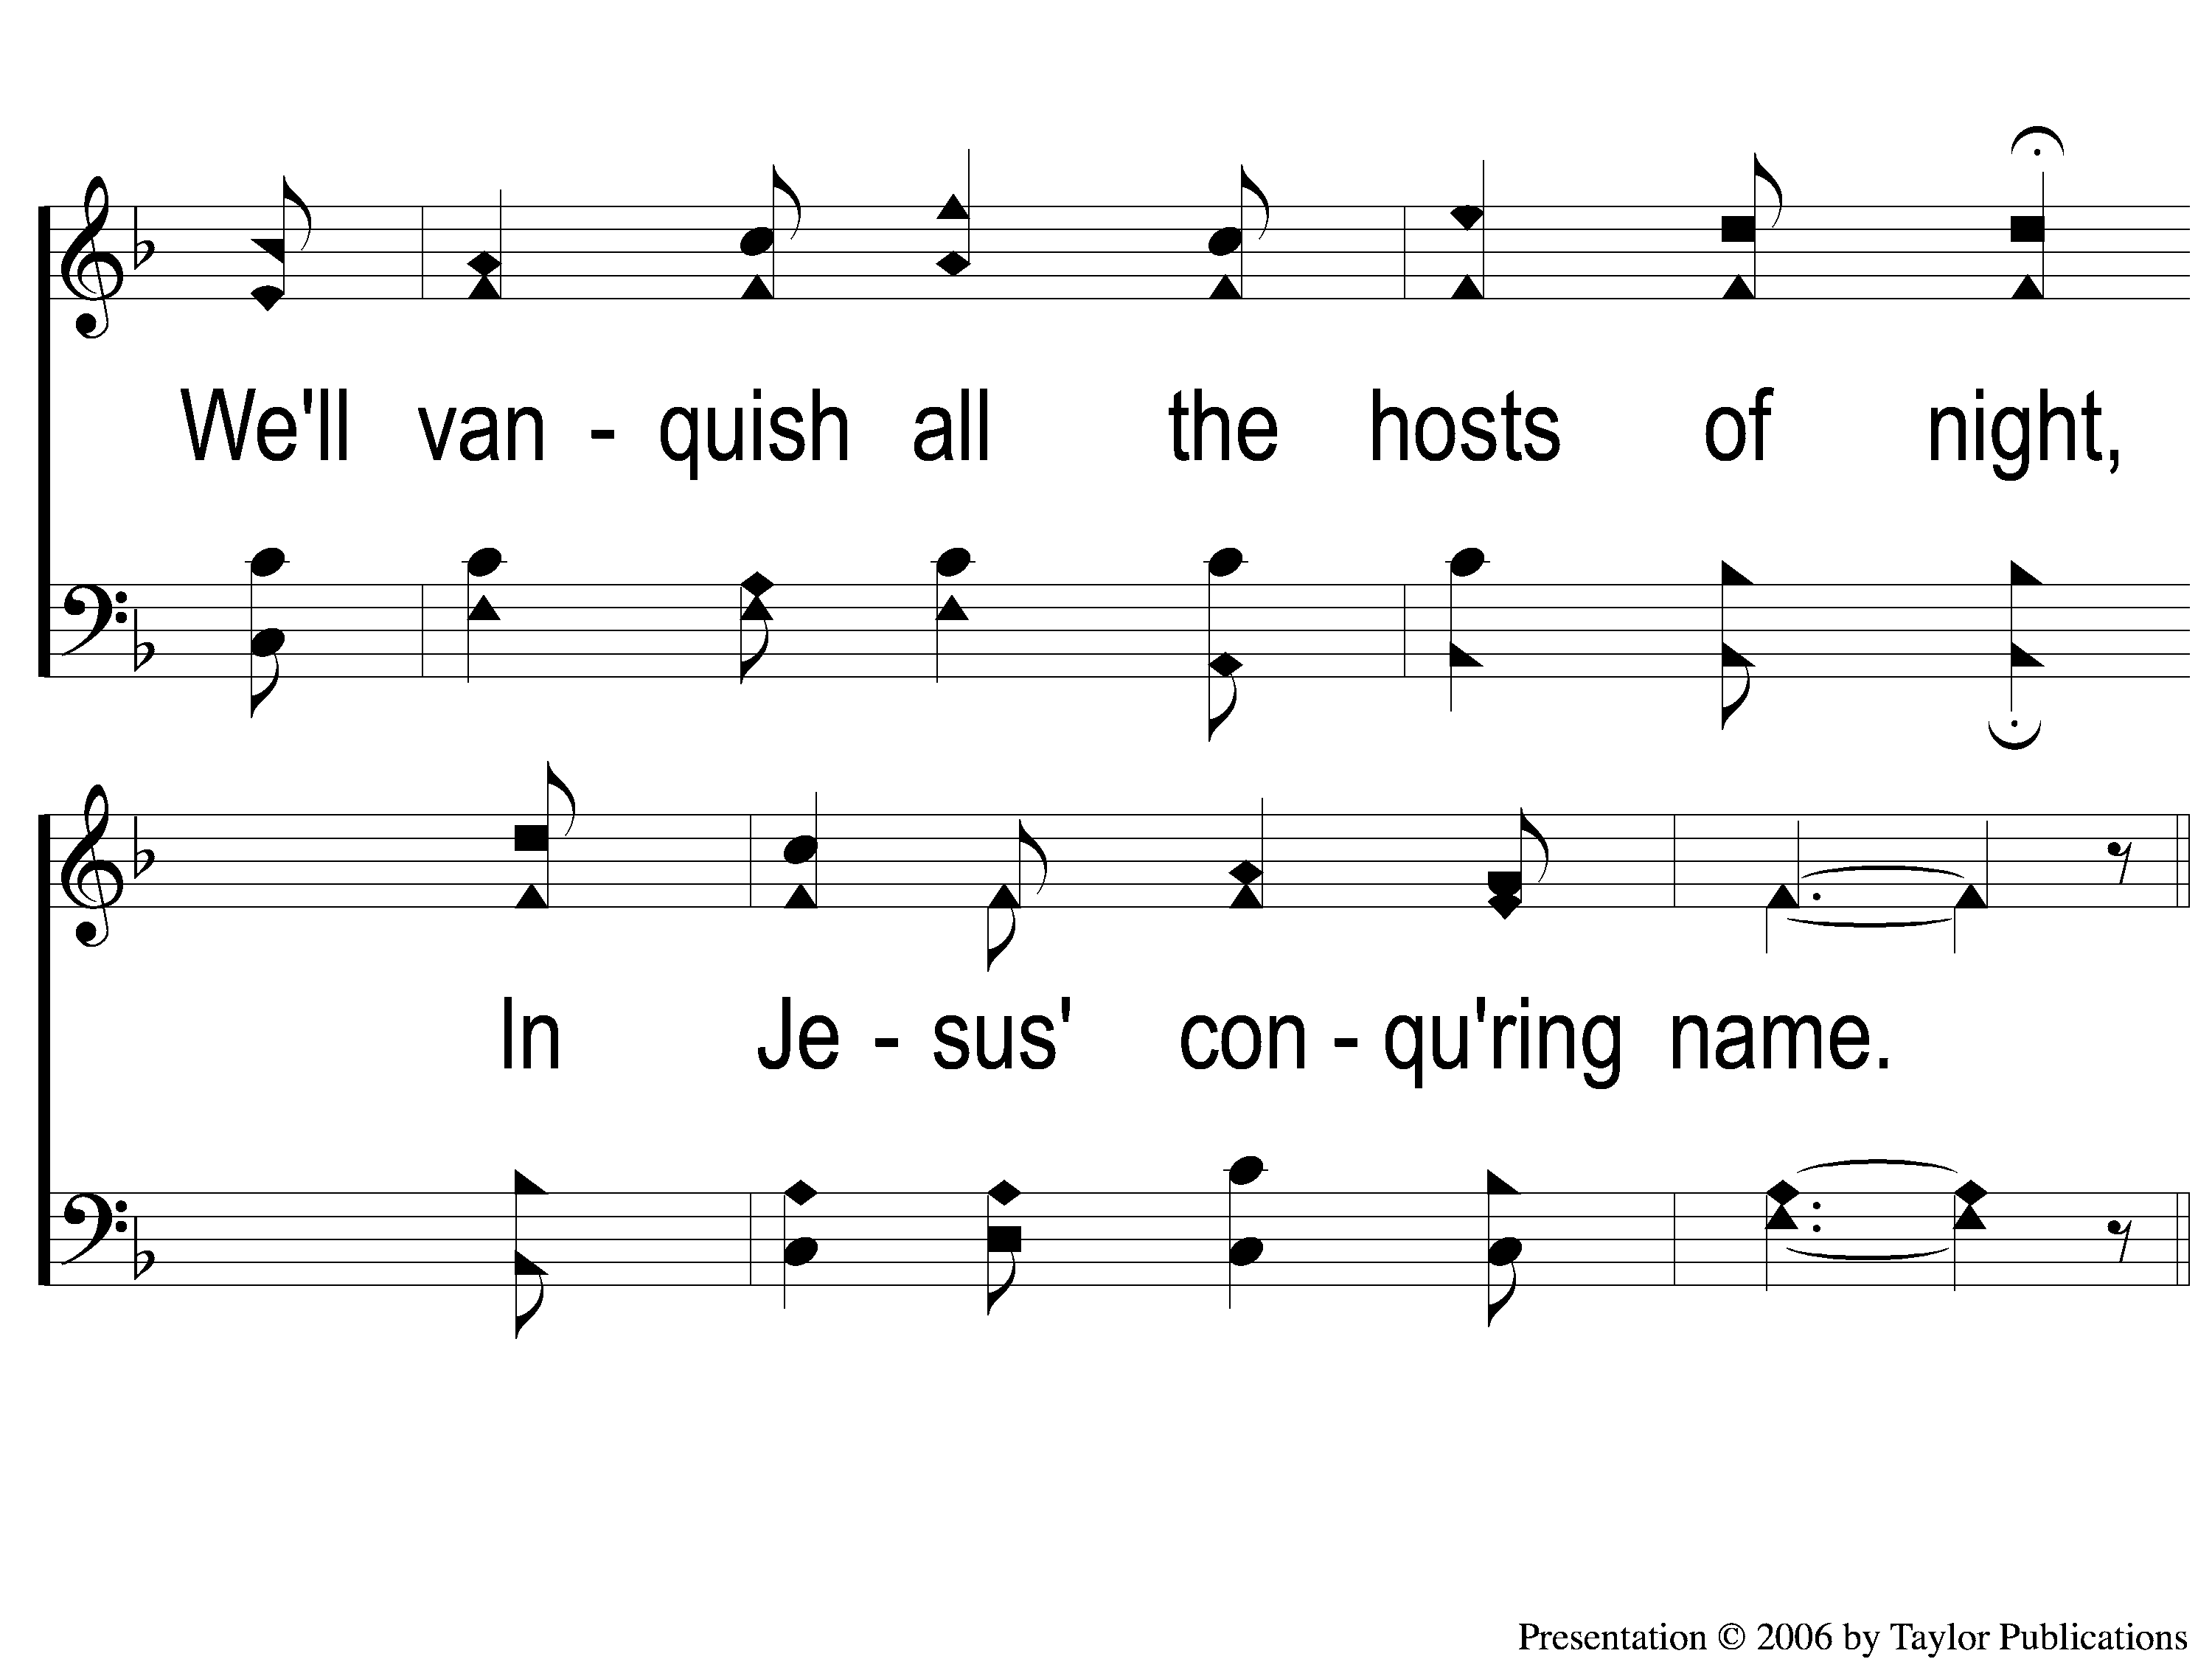
3-3 Faith is the Victory
Faith Is The Victory
97

Slide 12
C-1 Faith is the Victory
Faith Is The Victory
97

